Slide 1

DPSIMS
Architecture and Technology
Notes:
Title slide with embedded images

Slide 2
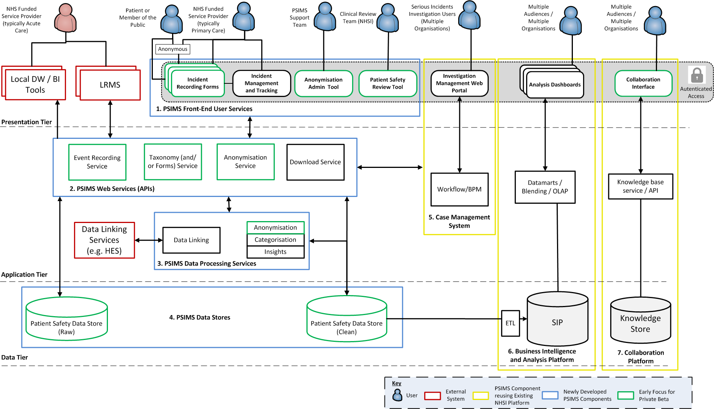
1. Solution Overview Solution Architecture
Notes:
Needs aligning with 7 Digital Capabilities

Slide 3
2. Re-use and integration with existing NHSI Platform Background
PSIMS will re-use and integrate new components with existing NHSI assets, benefiting from significant investment in recent years into:
Secure cloud hosting and application management
Identity Management
Data Management, Analytics and Visualisation
Case Management
Collaboration and Knowledge Sharing
The assets above are proven and in use by a variety of live services / systems for NHSI:
Cost Transformation Programme & PLICS
Model Hospital & GIRFT (Get it right first time)
HES & SUS+
PFMS (Financial Collection)
A&E National Dashboard
Analytics Hub Dashboards including: Single Oversight Framework, Patient Experience Headlines Tool, Operational Performance reports

Slide 4
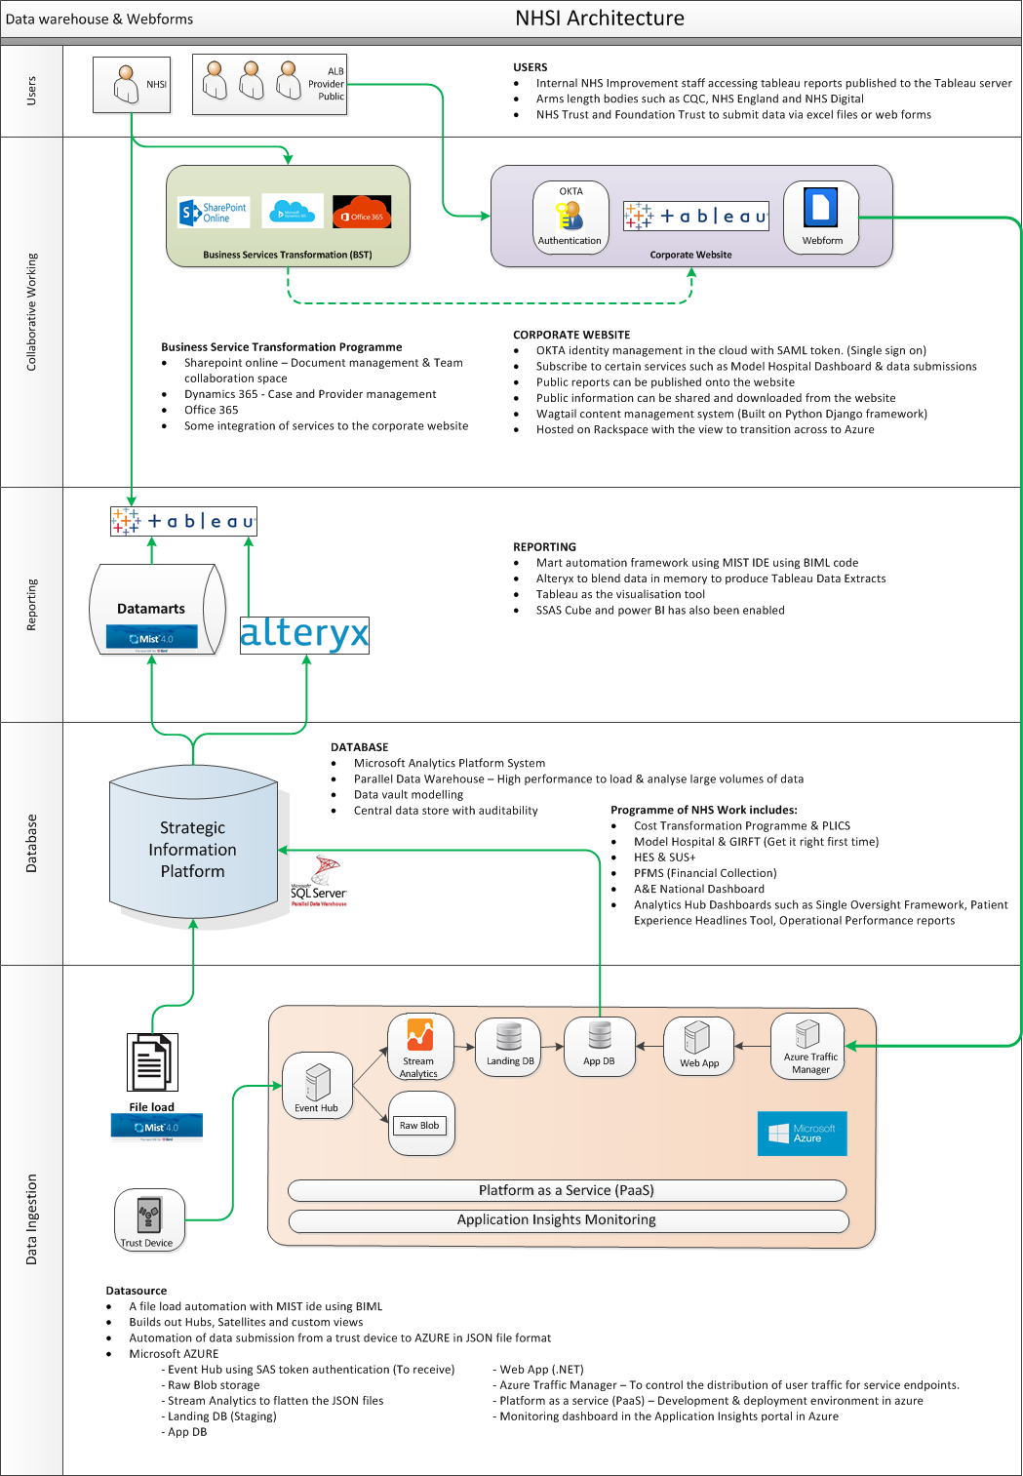
2. Wider NHSI Estate Technology landscape
Microsoft Azure platform services (inc. hosting, scaling, monitoring, security)
Microsoft Data Analytics and Data Platform (APS, Parallel Data Warehousing, Data Mart, MIST, BIML, SSAS, SSIS, Power BI, Application Insights Monitoring)
Identity Management and Authentication Services (OKTA - SAML based)
Data blending, transformation and visualisation (Alteryx, Tableau)
Collaboration and Knowledge Sharing (Improvement Hub – Python, Wagtail CMS)
Case Management and Business Process Management (MS Dynamics)

Slide 5
3. PSIMS Technology Choices Alpha prototyping and de-risking
Solution Area | Description | Alpha Technology
1. PSIMS Front-End User Services | Front end prototypes for: Local recording incidents National review of incidents | GOV.UK Prototype Kit (NodeJS) Azure app services
2 PSIMS Public Web Services (APIs) | Test stub REST APIs: Event Recording Service Taxonomy Service | Java Spring Boot Azure app service
3. Data Processing Services | Technical Spike into: Natural Language Processing tools for analysing free-text description of incidents | Ongoing SpaCy (Open Source Python NLP) LUIS (Microsoft)

Slide 6
3. PSIMS Technology Choices Alpha prototyping and de-risking
Solution Area | Description | Alpha Technology
4. PSIMS Data Stores | Data modelling set out a minimum useful learning dataset (based on discovery work). | Re-use of existing NHSI assets: Microsoft SQL Server Redis – in-memory data store to support Test APIs.
5. Business Intelligence and Analysis Platform | Dashboards for analysing publicly available patient safety data | Re-use of existing NHSI assets: Microsoft APS, Tableau, Alteryx

Slide 7
3. Technology Choices Private Beta
Solution Area | Description | Beta Technology
1. PSIMS Front-End User Services | New front-end services: Incident Recording Forms Patient Safety Review Tool Anonymization Admin Tool Incident Management and Tracking | Python (Django Framework)
2. PSIMS Web Services (APIs) | RESTful web services to be published for: Event Recording Service Taxonomy (and/or Forms) Service Anonymisation Service Download Service | Microsoft .NET Framework

Slide 8
3. Technology Choices Private Beta
Solution Area | Description | Beta Technology
3. PSIMS Data Processing Services | Free-text analysis capabilities to anonymise and enrich (e.g. auto-classy and provide insights) | Combination of best-of-breed technologies including: Microsoft Azure Services (e.g. LUIS) Open Source NLP tools (e.g. spaCy)
4. PSIMS Data Stores | Data Stores for persisting both ‘raw’ Patient Safety Data collection and ‘cleansed’ patient data. | SQL Server (Azure COMOS DB)

Slide 9
3. Technology Choices Private Beta
Solution Area | Description | Beta Technology
5. Case Management System | For incident investigation management, specially into Serious Incidents. | Re-use and configure existing NHSI asset: Microsoft Dynamics
6. Business Intelligence and Analysis Platform | Dashboards for analysing publicly available patient safety data | Re-use and configure existing NHSI asset: Tableau, Alteryx
7. Collaboration Service | Service for sharing learning across the NHS | Re-use and extend existing NHSI asset: Django (python) / Wagtail Open source CMS

Slide 10
LRMS Integration and Options Assessment
Option 1 (A and B)
Continue with the same data exchange mechanism (i.e. manual upload of an XML file).
1a - Use existing XML format and "translate" to the PSIMS data model within NHSI.
1b - Implement a new XML format aligned with the PSIMS data model.
Option 2 (A and B)
Risk Manager push button in LRMS to send data directly to an API.
2a - Existing XML structure.
2b - New XML structure.
Option 4 (A and B)
Capture data through PSIMS Online forms.
4a - LRMS pull data periodically from a PSIMS into there own system.
4b - Risk Manager downloads data from PSIMS website and manually imports into LRMS.
Option 3 (A and B)
Risk Manager push button in LRMS to save XML file to an agreed "location“.
3a - Existing XML structure.
3b - New XML structure.

Slide 11
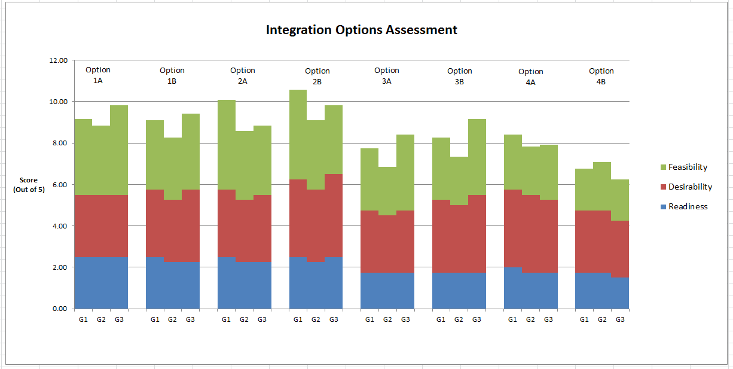
LRMS Integration and Options Assessment

Slide 12
4. Integration with Non-NHSI Systems Local Risk Management Systems
Current Issue | Impact | Beta Solution
Manual of data transfer | Time consuming, prone to error and lacks an explicit audit trail / history (e.g. organisations unsure of what they have and haven’t uploaded). | Event Service enabling fully integrated electronic transfer via a RESTful using a published XML schema.
Maintenance of “Mappings” | A barrier to national recording due to time and cost of set-up. Leads to data quality issues as “Mappings” diverge over time. | A RESTful taxonomy service for LRMSs to record data against a national classification / coding system.
Difficulty to introduce change | Inhibits ability to evolve Patient Safety data to continuously meet the user need. Incurs additional cost to provers of care to implement software changes to their systems. | Taxonomy service will enable additions, removal, updates to classifications centrally.
Time lag for reporting | Reducing ability to act as an early warning system and spot national trends early. | Event Service supports single incident recording and updates to incidents. LRMS vendors to be encouraged to take advantage of these features.
Incidents with PII | Increased work load for NHSI to cleanse. | Anonymisation Service for LRMSs to use to scan data pre-submission and alert users of potential issues.
Missing incidents not reported through LRMS | Reduces ability for providers to perform risk management and patient care duties, including for multi-organisation incidents. | Download Service for LRMSs to obtain anonymised data records.
UX reducing data quality | Ambiguous questions and poor user experience leading to data quality issues and complexity for front-line staff leading to reduced reporting. | Option to extend the Taxonomy Service into a full-blown Forms Service, delivering a full JSON response that could be rendered by the LRMS.

Slide 13
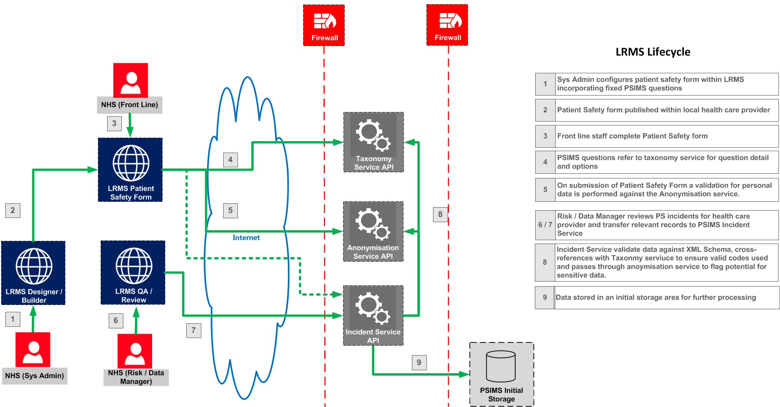
4. Integration with Non-NHSI Systems Local Risk Management Systems

Slide 14
5. Open Standards, Open Data and Common Platforms Patient Safety Data Standard
Data sharing and standardisation to improve data quality and usefulness
Working with NHSD toward a Patient Safety Data Standard
Fast Healthcare Interoperability Resources (FHIR)
Aligned with standard terms / vocabs (SNOMED CT)

Slide 15
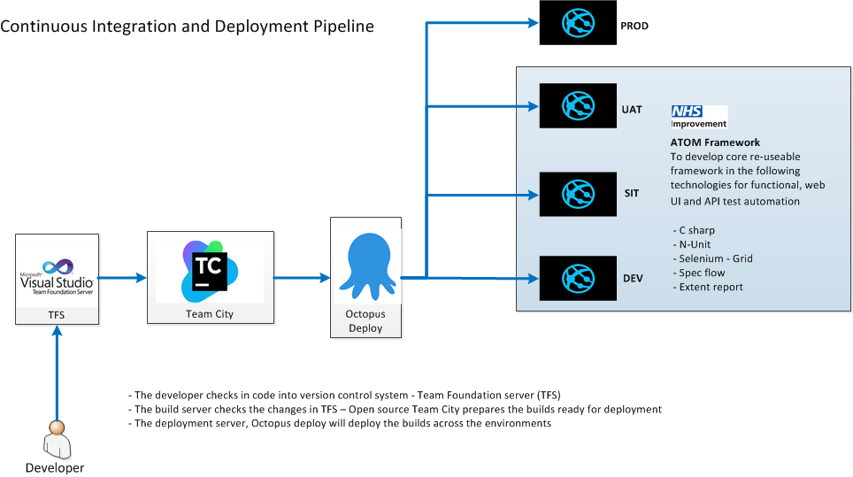
4. Development Toolchain

Slide 16
4. Development Practices Making Source Code Open and Re-usable
During the beta phase we will:
Open Source all code for PSIMS (outside of Microsoft and other COTS product sets).
Complete in-sprint development in a private NHSI repository within NHSI infrastructure to align with the working practices / tooling of other teams.
Release code to a publicly accessible GitHub repository for sharing and re-use, periodically (e.g. at major release points)
Any configuration files or other sensitive data will not be made public.

